Slide 1
Marketing Operations
Hot Topics 2
Phil Cuff
6th November 2024

Slide 2
Agenda
Welcome
Best Practice: Hot Topics 2
Open Q&A/Discussion

Slide 3

Marketing Operations Open Office Hours
Get your questions answered by the marketing automation team. MA Open Office Hours are held monthly with the following agenda:
  Learn about a tip or best practice
  Ask a question – Pre-submit your questions here or ask during the office hours
  Learn how to leverage IQVIA’s marketing systems and processes most effectively
Action: Sign up here, if you need to be added to the outlook invite
Reminder: Save your questions for the end or enter in the chat. We will address as many as we can!

Slide 4


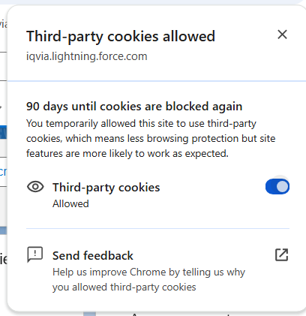
Engage issue in Salesforce
Users facing issue with accessing Engage in Salesforce
Seeing a grey error screen
Issue is as a result of 3rd party cookies being blocked
Can be resolved by enabling 3rd party cookies in Chrome
In the address bar click on the eye icon with a line through it and then toggle 3rd party cookies to be allowed
May need to do this every 90 days

Slide 5
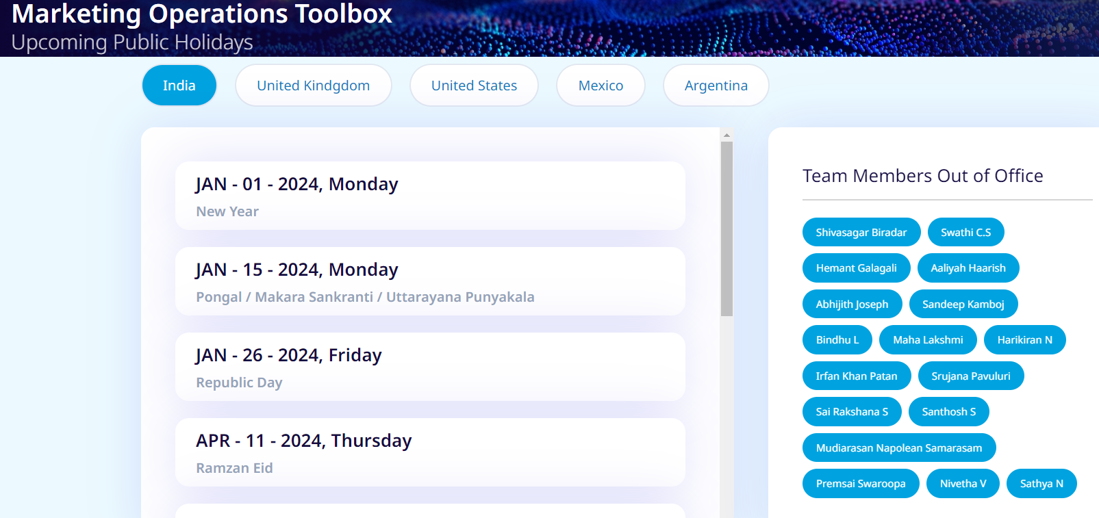
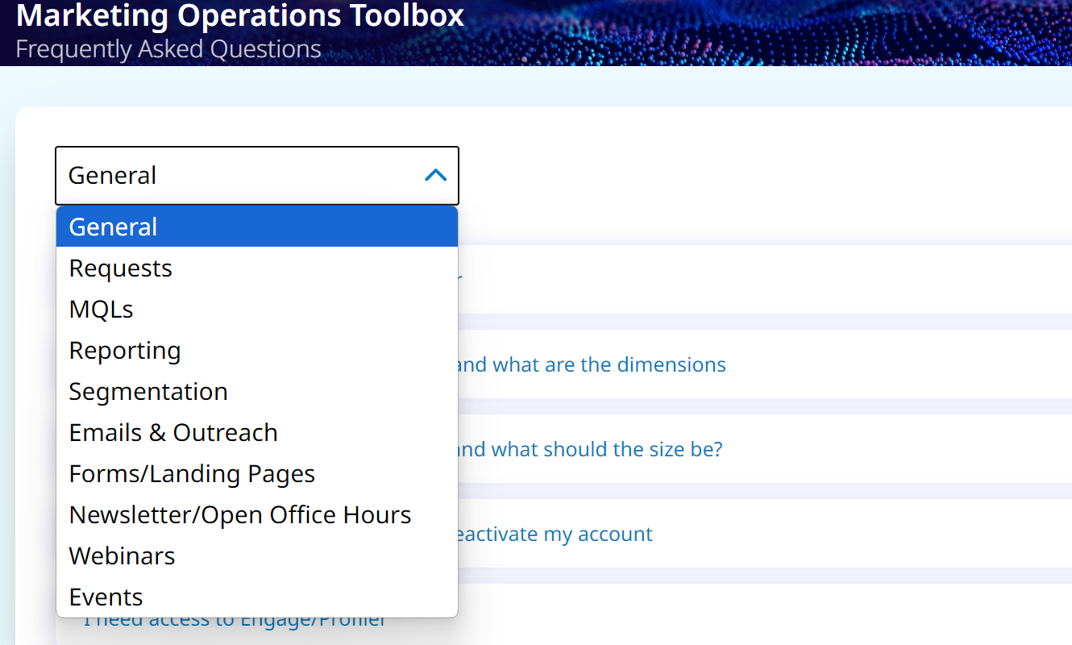
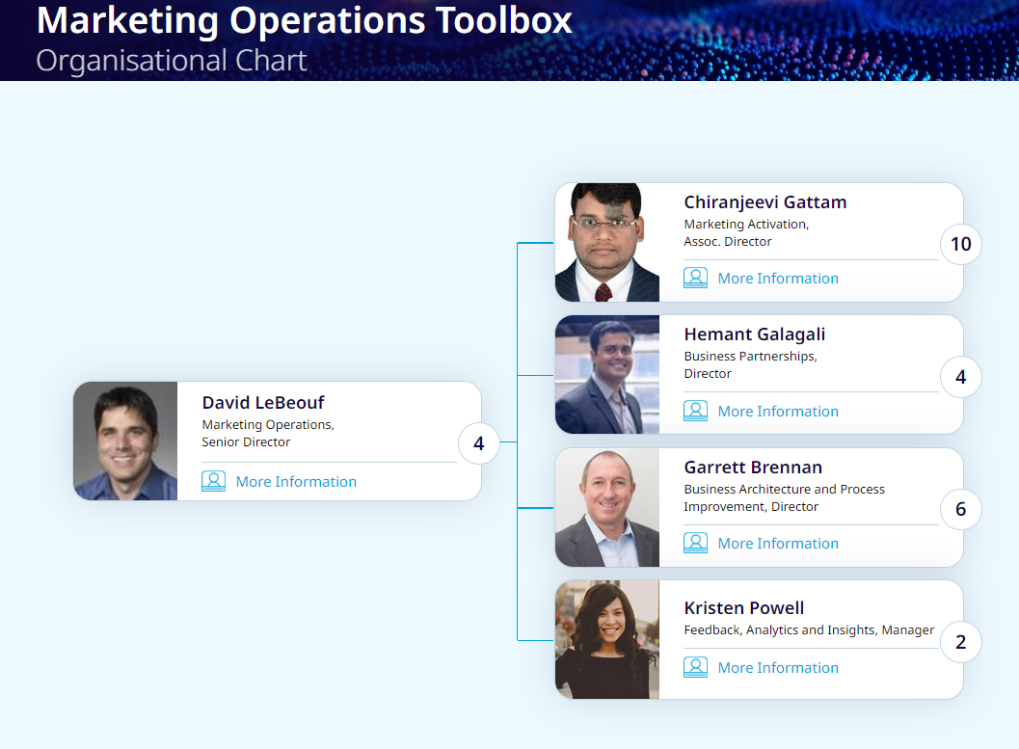
Toolbox Updates
Additional updates to Toolbox going live this week
  Updated FAQs
  Organizational Chart
  Public Holiday Calendar
Final updates still to be completed in the coming weeks include
  Additional resources added to the Resources section (Direct Marketing guidance, Global privacy etc)
  Word doc versions of EPG Health templates hosted in Help section

Slide 6
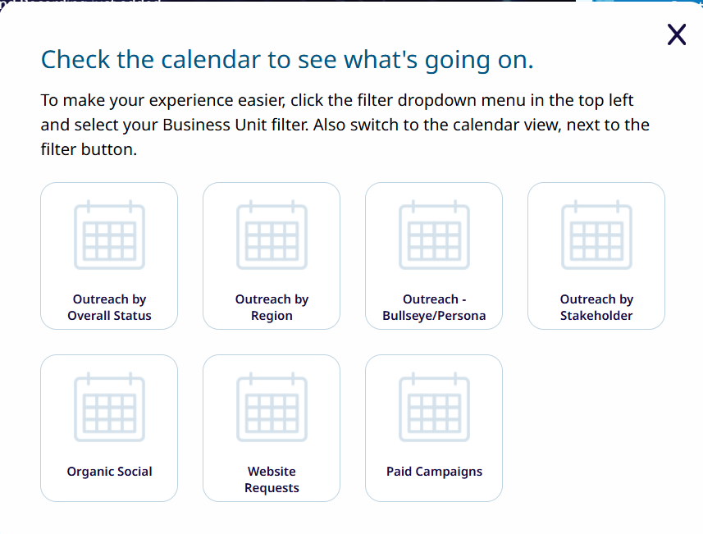
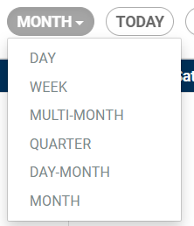
Calendars
We have 7 calendars available to marketers, 4 specific to Outreach requests
  Outreach by Overall Status – Displays all Outreach Requests by their Status and can be filtered by Region, Audience or Status
  Outreach by Region – Displays Outreach by Region and Reporting Group and can be filtered by Region
  Outreach by Bullseye/Persona – Displays Outreach by Region and can be filtered by Bullseye/Persona
  Outreach by Stakeholder – Displays Outreach by the Marketer/Lead email address and can be filtered by Marketer
  Organic Social – Displays Organic Social requests (color coded by status) and can be filtered by Content Type and Reporting Group
  Website Requests – Displays Website requests, color coded by status, and can be filtered by Type and Reporting Group
  Paid Campaigns – Displays Paid Search and Paid Social campaigns, color coded by status and can be filtered by Campaign Type and Reporting Group
Within each calendar you are able to filter, change the viewing period and you can also download

Slide 7
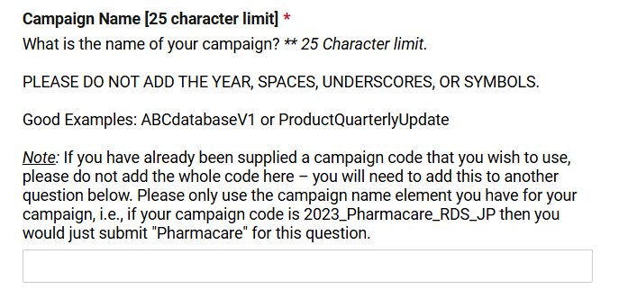
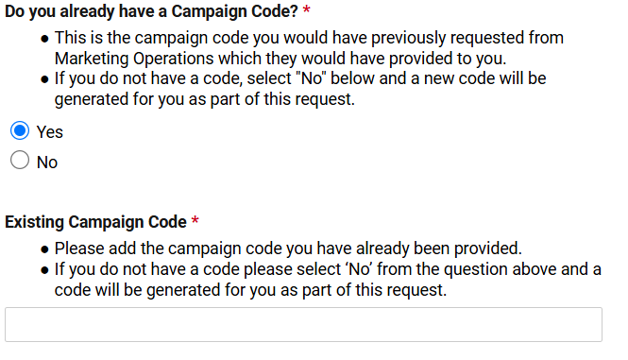
Campaign Codes
You will now need to have a campaign code before you can complete the following requests:-
  Organic Social
  Paid Social
  Paid Search
  External Activities Uploads
When requesting a campaign code don’t paste in a full campaign code
You can paste the full campaign code into the Campaign code fields on the various forms

Slide 8
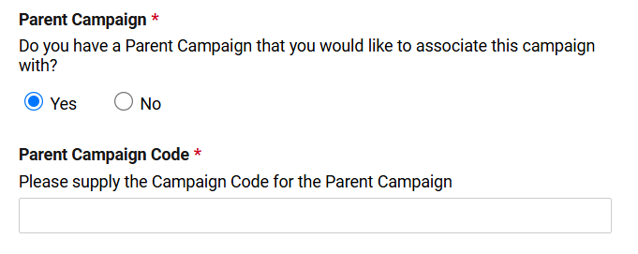
Parent campaign codes
Recently added fields related to Parent Campaign Codes on the Outreach request and Campaign Code only request forms
Process is designed to save marketers time and ensure a smoother set-up of parent/child campaigns
You can select if you have a parent campaign to link to and supply the full parent campaign code
Marketing Operations will then link the campaigns and this will be reflected in Salesforce

Slide 9
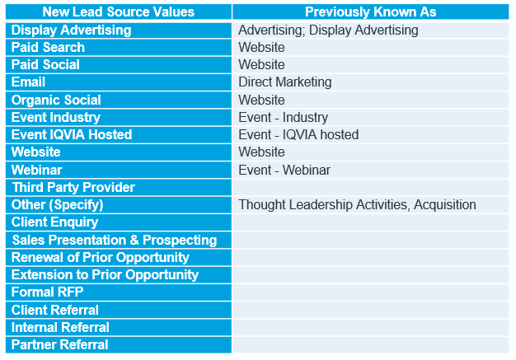
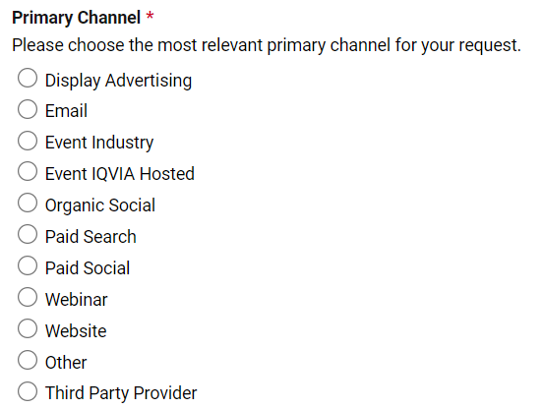
Lead Source Value Updates
Lead Source values were updated on 21st October in Salesforce
These changes will improve data accuracy and consistency across campaigns, helping us better track lead performance and optimize marketing strategies.
Request forms have been updated (Campaign Code only, Landing Page only, External Activities)
New values have been added to the picklists in Eloqua:-
  Lead Source
  MQL Source
  Channel (Custom Campaign Field)
Any uncertainty please reach out to Kristen or Phil

Slide 10
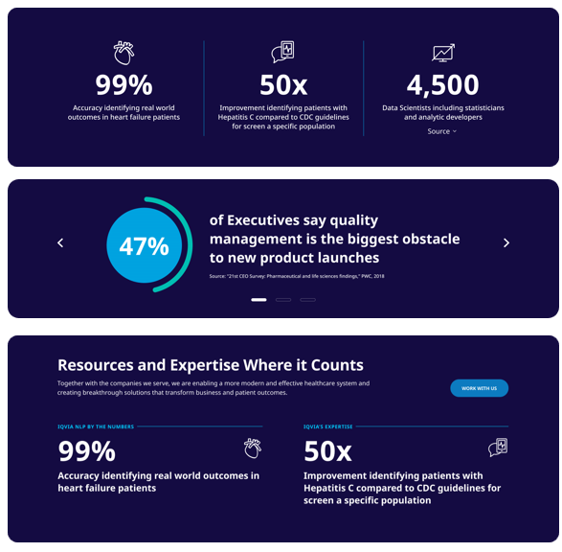
Enhanced proof point modules
LIVE
Enhanced Proof-point modules now available. Adding more variety, including various numerical call-outs and improved carousel experience to make stats or claims pop much more for users.

Slide 11
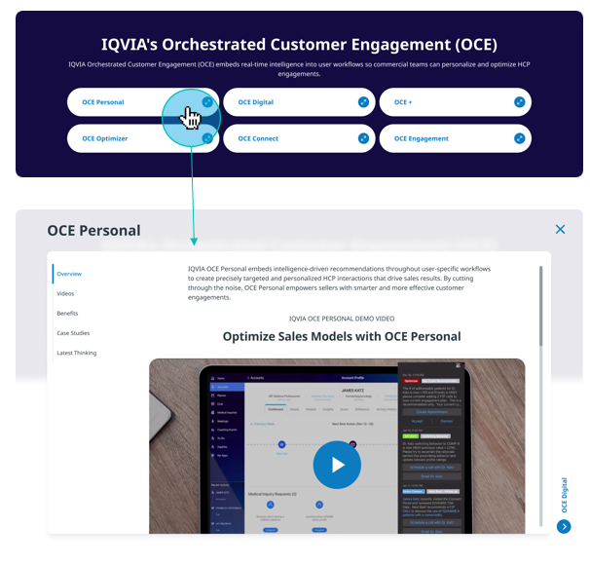
Tabbed Popup Widget
LIVE
New Tabbed Popup Widget available for use in your page layouts. Designed for a suite of products or multiple related offerings/topics, this interactive module opens content within a pop-up window to allow visitors to deep dive into content without leaving the page.
Notes:
Replace Ceros – add list of modules (they’re in website module deck), defuse additional click objection – engagement is what matters. Replaces all the Arc modules

Slide 12
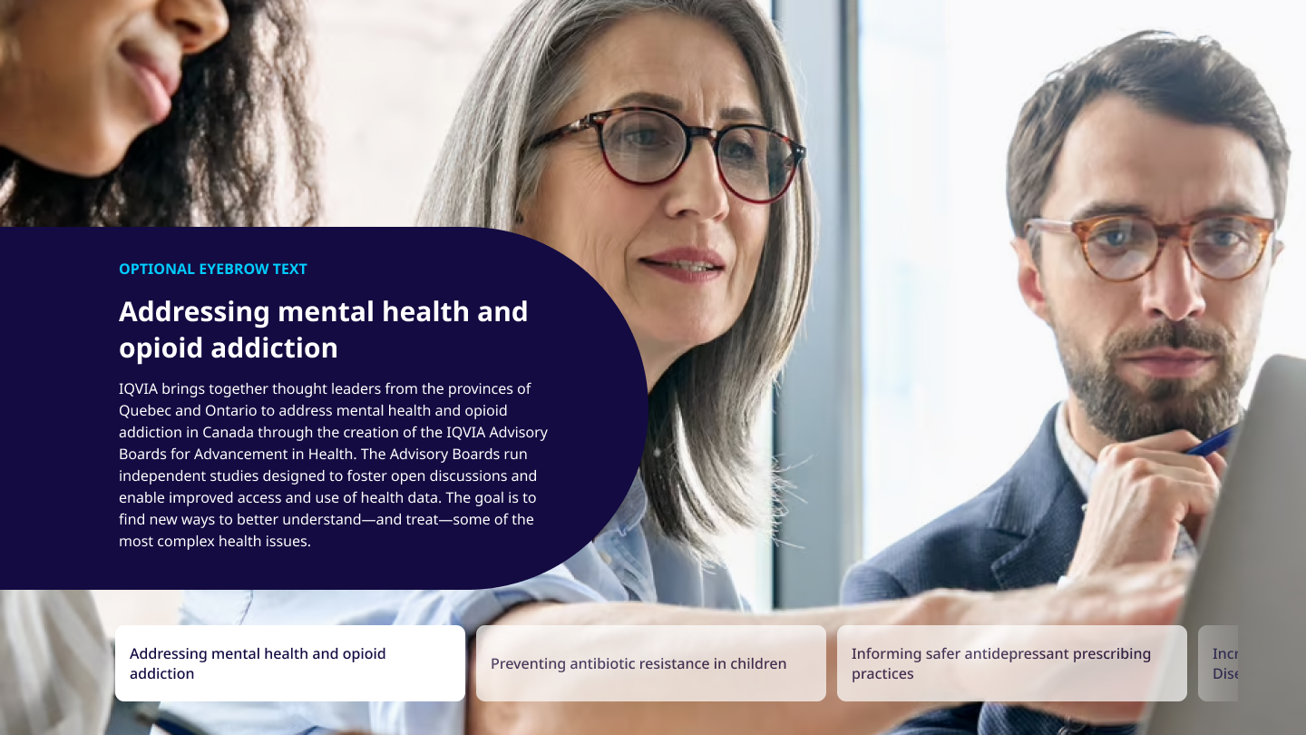
Feature Story
LIVE
We are excited to launch the new Feature Story module. This module is crafted to provide an engaging and interactive experience, perfect for showcasing key stories or topics. It includes striking full-bleed background images and an intuitive tile-based navigation system for seamless story transitions.
Notes:
Impact stories are a good example use case for this module

Slide 13
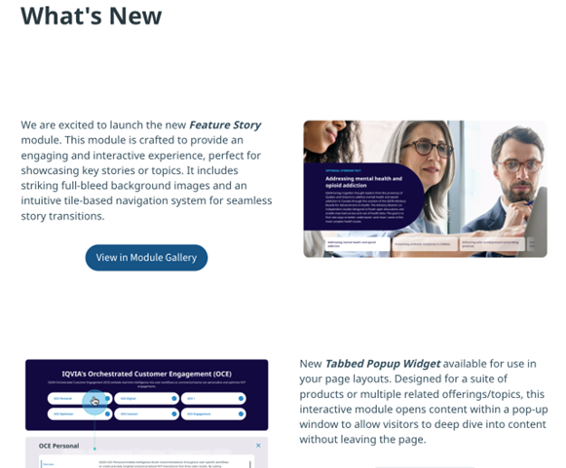
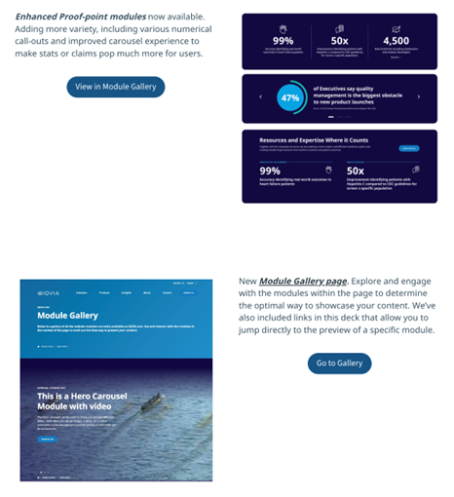
“What’s New” page added to Brand World website guidelines
https://brandworld.iqvia.com/guidelines/guide/bf2ae22c-d796-4613-bc79-ca168125730a/page/92c0f85b-3d67-4e41-bb4d-029220fb56b7

Slide 14
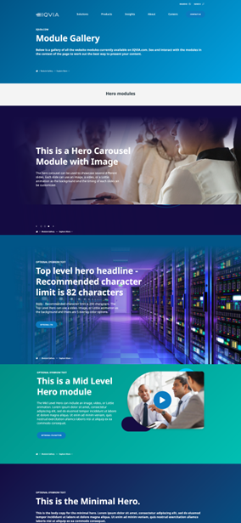
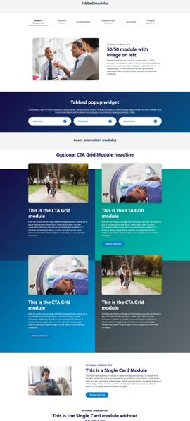
Module gallery page
http://cms-www.work.iqvia.com/landing/module-gallery
Explore and engage with the modules within the page to determine the optimal way to showcase your content.
We’ve also included links in the Webpage Module Template deck that allow you to jump directly to the preview of a specific module.

Slide 15
New Module Development: Planned Timeline
Conversational Search launch
Blog Landing Page – Redesign
Blog Category – Redesign
Audio Clips 50-50
Audio Clips Carousel
Audio Clips Single Card
FAQ Accordion
Tabbed Popup Widget - LIVE
Proof Point/Stat - LIVE
Proof Point/Stat Icon - LIVE
Proof Point/Stat Image-Text Carousel - LIVE
Q3 2024
Q4 2024
Q1 2025
Q2 2025
Feature Story - LIVE
Conversational Search in Test
Horizontal Storytelling
Quote Testimonial
Content Ticker
Interactive Case Study
Main Navigation – Redesign
Sub Navigation – Redesign
*Please note that timeline can change based on many factors including budget & priorities*
Notes:
Ops - Garrett

Slide 16
Thank You

